Slide 1
Unit 3: Reference Model (6 Hours)
3.1 Protocol and Protocol Layers, Architecture
3.2 OSI Reference Model and functions
3.3 TCP/IP Protocol,
3.4 Cross layers
3.5 Devices different layers
3.6 Software defined networks

Slide 2
3.1 Protocol and Protocol Layers, Architecture

Slide 3
Layers Architecture
Layered architecture in computer networks refers to dividing a network's functioning into different layers, each responsible for a certain communication component.
The major goal of this layered architecture is to separate the complex network communication process into manageable, smaller activities that can be better developed.

Slide 4
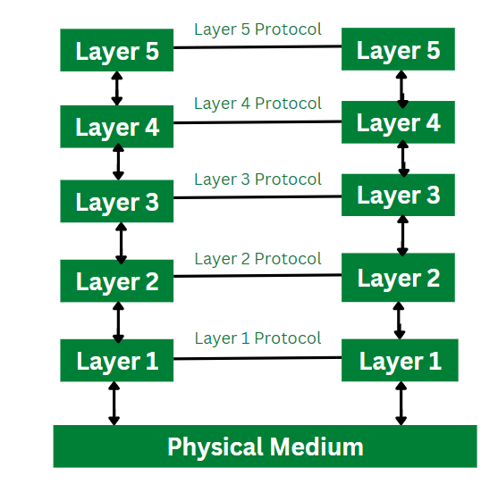
Every network consists of a specific number of functions, layers, and tasks to perform.
Layered Architecture in a computer network is defined as a model where a whole network process is divided into various smaller sub-tasks.
These divided sub-tasks are then assigned to a specific layer to perform only the dedicated tasks.
A single layer performs only a specific type of task.
To run the application and provide all types of services to clients a lower layer adds its services to the higher layer present above it.
Therefore layered architecture provides interactions between the sub-systems.
If any type of modification is done in one layer it does not affect the next layer.

Slide 5
Features of Layered Architecture
Use of Layered architecture in computer network provides with the feature of modularity and distinct interfaces.
Layered architecture ensures independence between layers, by offering services to higher layers from the lower layers and without specifying how these services are implemented.
Layered architecture segments as larger and unmanageable design into small sub tasks.
In layer architecture every network has different number of functions, layers and content.
In layered architecture, the physical route provides with communication which is available under the layer 1.
In layered architecture, the implementation done by one layer can be modified by another layer.

Slide 6
Evolution of Layered Architecture
In computer networks, layered architecture is majorly used for communication.
The two network models that makes use of layered architecture are:
OSI Model
TCP/IP Model

Slide 7
3.2 OSI Reference Model and functions
The open systems interconnection (OSI) model is a conceptual model created by the International Organization for Standardization which enables diverse communication systems to communicate using standard protocols.
It is a 7-layer architecture with each layer having specific functionality to perform.
All these 7 layers work collaboratively to transmit the data from one person to another across the globe.
The OSI reference model was developed by ISO – ‘International Organization for Standardization‘, in the year 1984.
The OSI model provides a theoretical foundation for understanding network communication.
However, it is usually not directly implemented in its entirety in real-world networking hardware or software.
Instead, specific protocols and technologies are often designed based on the principles outlined in the OSI model to facilitate efficient data transmission and networking operations.
The OSI Model can be seen as a universal language for computer networking.

Slide 8
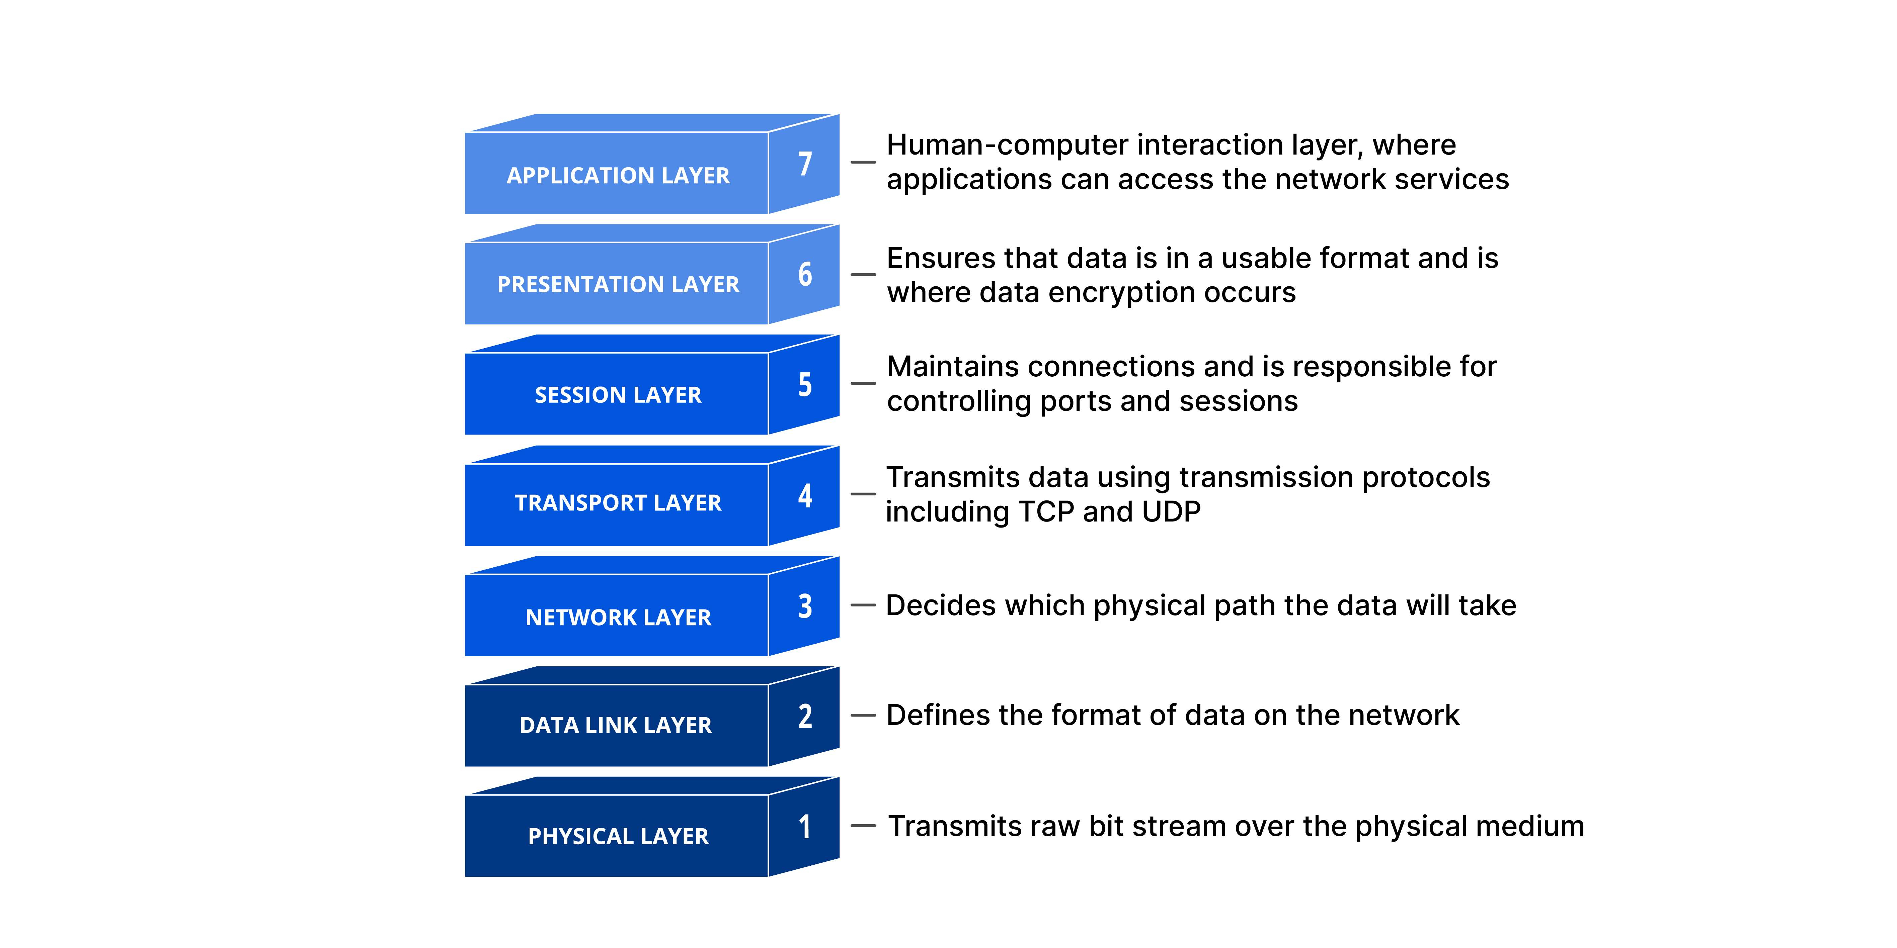

Slide 9
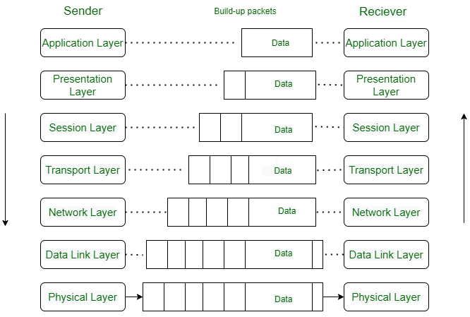
packet
message
frame
bit

Slide 10
Layers and Functions
For the OSI model, let’s start at the top layer and work our way down.
Layer 7 (Application): Most of what the user actually interacts with is at this layer. Web browsers and other internet-connected applications (like Skype or Outlook) use Layer 7 application protocols.
Layer 6 (Presentation): This layer converts data to and from the Application layer. In other words, it translates application formatting to network formatting and vice versa. This allows the different layers to understand each other.
Layer 5 (Session): This layer establishes and terminates connections between devices. It also determines which packets belong to which text and image files.

Slide 11
Layer 4 (Transport): This layer coordinates data transfer between system and hosts, including error-checking and data recovery.
Layer 3 (Network): This layer determines how data is sent to the receiving device. It’s responsible for packet forwarding, routing, and addressing.
Layer 2 (Data Link): Translates binary (or BITs) into signals and allows upper layers to access media.
Layer 1 (Physical): Actual hardware sits at this layer. It transmits signals over media.
The TCP/IP model, sometimes referred to as a protocol stack, can be considered a condensed version of the OSI model.

Slide 12
3.3 TCP/IP Protocol

Slide 13
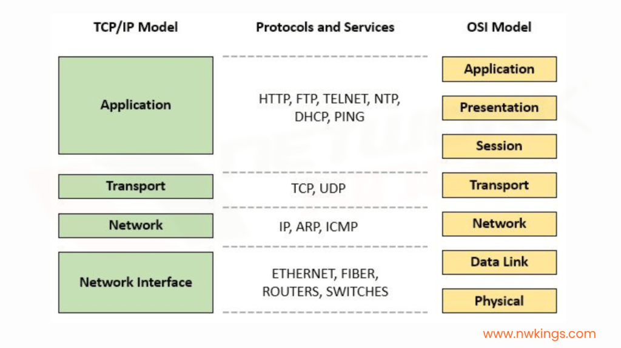
These layers are divided in such a way that each layer uses the output of the layer right below it, performs the allocated functions, and prepares the input for the next layer, or vice versa.
This layered architecture is called the four -layer internet protocol stack.
There are four layers in the internet protocol stack, as shown in the table below

Slide 14
Application layer
As suggested by its name, the application layer is responsible for communication between applications running on two different end systems.
A message or data transferred from one end is readable for the corresponding application on the other end. These applications include web browsers, email clients, etc.
At the application layer, the data being transferred is called a message.
The protocols used at the application layer include:
Hypertext Transfer Protocol (HTTP): for transferring HTML web documents
File Transfer Protocol (FTP): for transferring files
Simple Mail Transfer Protocol (SMTP): for transferring e-mail messages
Domain Name System (DNS): for translation of human-friendly domain names into IP addresses

Slide 15
Transport layer
On the sending end, the transport layer is responsible for collecting the application layer message from the relevant end-point and transferring it to the network layer to be communicated over the network.
The receiving end collects the message from the network layer and passes it on to the relevant end-point where the application layer can access that message.
These end-points are called sockets.
The transport layer uses a unique identifier called a port number to identify the correct socket or application.

Slide 16
The message received from the application layer might be broken into chunks at this layer.
The transport layers add a header with its own information on top of the message received from the application layer. The unit of data at the transport layer is called a segment.
The two important protocols used in the transport layer are:
Transmission Control Protocol (TCP): for reliable and connection-oriented data transfer
User Datagram Protocol (UDP): for fast, unreliable, and connection-less data transfer
Connection-oriented means that TCP establishes the connection first and then transmits the data. On the other hand, UDP is connection-less, which means that it just sends the data without checking if it is being received or not.

Slide 17
Internet Layer
The Internet layer performs the task of controlling the transmission of the data over the network modes and enacts protocols related to the various steps related to the transmission of data over the channel, which is in the form of packets sent by the previous layer.
This layer performs many important functions in the TCP/IP model, some of which are:
It is responsible for specifying the path that the data packets will use for transmission.
This layer is responsible for providing IP addresses to the system for the identification matters over the network channel.
Some of the protocols applied in this layer are:
IP: This protocol assigns your device with a unique address; the IP address is also responsible for routing the data over the communication channel.
ARP: This protocol refers to the Address Resolution Protocol that is responsible for finding the physical address using the IP address.

Slide 18
IPv4: widely used protocol for communication over the internet and uses a 32-bit IP address
IPv6: proposed to replace IPv4 with the IP addresses of 128-bits because 32-bit IP addresses will be insufficient with the high number of computers being connected to the internet
Another protocol used at this layer for error-reporting is the Internet Control Message Protocol (ICMP).
ICMP requests the sender to resend the data if the data is not received or received in the wrong order on the other end.
It is simply a protocol that transfers information about the data, not the data itself.
It is different from IPv4 or IPv6 as it does not rely on TCP or UDP. It does not ensure a reliable connection before sending a message.

Slide 19
Network Access Layer
This layer is the combination of data-link and physical layer, where it is responsible for maintaining the task of sending and receiving data in raw bits, i.e., in binary format over the physical communication modes in the network channel.
It uses the physical address of the system for mapping the path of transmission over the network channel.
Till this point in this tutorial on what is TCP/IP model, you understood the basic idea behind the model and details about its layers, now compare the model with

Slide 20
Data Link layer
When a packet is being transferred over the internet, several intermediate devices are between the two end systems. These devices may be routers, switches, or other computers.
The link layer is responsible for communication between one device and its immediate neighbor.
The protocols and methods used for one link might differ from the protocol used in the next immediate link, even if the destination and data packet remain the same.
The link layer adds a header with its information on top of the packet it receives from the network layer.
The data packet at the link layer is called a frame.
The link-layer is mostly implemented in the network adapter/network interface card (NIC), and technologies like ethernet, Wi-Fi, token ring, etc., are associated with the link layer.

Slide 21
Physical layer
physical layer is responsible for breaking the data frame into bits, converting it into a form that can be transmitted over the physical communication line, and transferring it.
This form could be light pulses (fiber-optic), radio waves (for wireless communication, or electric pulses (for wired communication).
On the receiving end, the physical layer collects the stream of bits and reassembles it into a data frame that is then passed onto the link layer for further processing.
The protocols and rules used at this layer are dependent on the kind of communication medium being used. For example, ethernet (link layer protocol)

Slide 22
Network Protocol Stack:
The protocol stack or network stack is an implementation of a computer networking protocol suite or protocol family.
A protocol stack or protocol suite is the architecture of a protocol that follows the layered architecture design principle.
The functionality of the whole protocol is broken down into component protocols that are separately managed and can be treated and designed mostly independently from one another.
A protocol stack typically contains a set of protocols where each protocol in the stack performs a specific task and is responsible for a well-defined function.
The protocols are often referred to as layers with each layer providing services to the layer above it and receiving services from the layer below it.

Slide 23
The network protocol stack refers to the set of protocols and layers that define how data is transmitted and received over a network.
The most commonly referenced protocol stack is the TCP/IP (Transmission Control Protocol/Internet Protocol) stack.
It consists of several layers, including:
Application Layer (Layer 5): This layer deals with application-specific protocols and services, such as HTTP (Hypertext Transfer Protocol), SMTP (Simple Mail Transfer Protocol), and DNS (Domain Name System).

Slide 24
Transport Layer (Layer 4): The transport layer provides end-to-end communication between devices.
Protocols like TCP (Transmission Control Protocol) and UDP (User Datagram Protocol) operate at this layer, managing reliable or unreliable data transfer.
Network Layer (Layer 3): The network layer is responsible for addressing, routing, and logical network connections.
IP (Internet Protocol) is the primary protocol used at this layer.
Data Link Layer (Layer 2): This layer ensures reliable transmission of data frames across a physical network. Ethernet is a common data link layer protocol.
Physical Layer (Layer 1): The physical layer deals with the actual transmission of data bits over physical media, such as copper wires, fiber optics, or wireless signals.

Slide 25
3.4 Cross layers

Slide 26
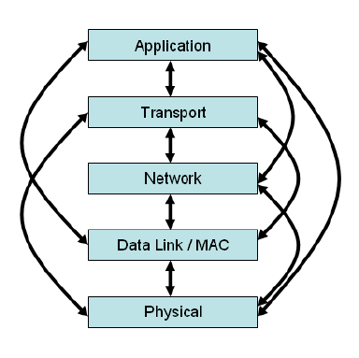
Cross-layer is a design approach in communication systems that allows communication and information sharing between different, usually separated, layers of the network stack to improve performance.
Instead of strictly adhering to a layered architecture like the OSI model, cross-layer design enables cooperation between layers to optimize things like data throughput, energy efficiency, and quality of service.
This is particularly useful in wireless and ad hoc networks where factors like the physical environment and energy consumption are critical.

Slide 27
How it works
Information sharing: Layers share information with each other, either through direct communication or via a common database.
Inter-layer cooperation: Protocols from different layers can work together.
For example, the physical layer can provide information about the channel's condition to a higher layer, which can then use that information to adapt its data rate or coding scheme.
Optimization: The goal is to optimize overall system performance by making decisions based on a broader context than what a single layer can see.

Slide 28
3.5 Devices different layers

Slide 29
In computer networking, various network entities and layers work together to enable communication between devices.
Let's explore some of the key network entities and layers commonly used in networking protocols:
1.Network Interface Card (NIC): A Network Interface Card, also known as a network adapter or network interface controller, is a hardware component that connects a device (e.g., a computer or a server) to a network.
It enables the device to transmit and receive data over the network.

Slide 30
2.Switch: A switch is a network device that operates at the data link layer (Layer 2) of the networking protocol stack.
It receives incoming data frames and forwards them to the appropriate destination based on the MAC (Media Access Control) addresses of the devices connected to the switch.
Switches facilitate the creation of local area networks (LANs) by connecting multiple devices together.
3.Router: A router operates at the network layer (Layer 3) and is responsible for forwarding data packets between different networks.
It examines the IP (Internet Protocol) addresses of packets to determine the optimal path for delivery.
Routers are crucial in connecting multiple networks together to form the internet.

Slide 31
4 Firewall:
A firewall is a security device or software that filters network traffic based on predetermined security rules.
It operates at various layers of the protocol stack, including the network, transport (Layer 4), and application (Layer 7) layers.
Firewalls help protect networks by controlling and monitoring incoming and outgoing traffic, preventing unauthorized access and potential threats.

Slide 32
3.6 Software defined networks

Slide 33
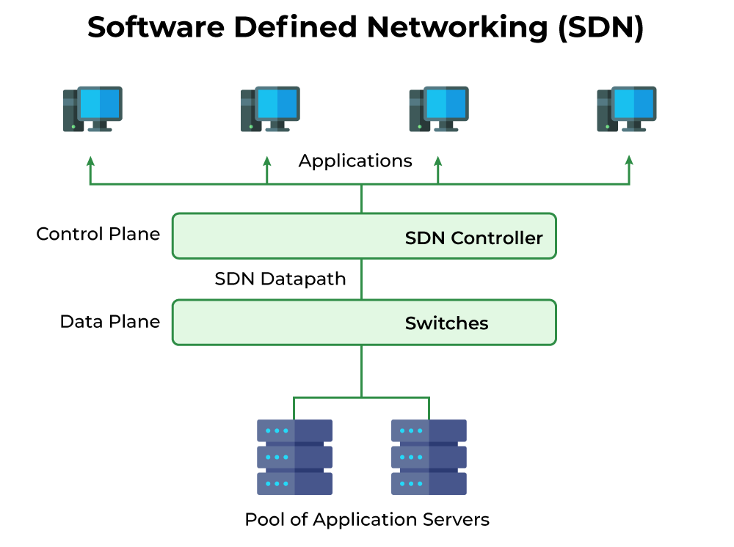
Software defined networking (SDN)
Is an approach to network management that enables dynamic, programmatically efficient network configuration to improve network performance and monitoring.
It is a new way of managing computer networks that makes them easier and more flexible to control.
In traditional networks, the hardware (like routers and switches) decides how data moves through the network, but SDN changes this by moving the decision-making to a central software system.
This is done by separating the control plane (which decides where traffic is sent) from the data plane (which moves packets to the selected destination).

Slide 34
SDN Architecture
In a traditional network, each switch has its own control plane and data plane.
Switches exchange topology information to build a forwarding table that decides where to send data packets.
In Software-Defined Networking (SDN), the control plane is removed from switches and assigned to a centralized SDN controller.
This allows network administrators to manage traffic from a single console instead of configuring each switch individually.
The data plane remains in the switch, forwarding packets based on flow tables set by the controller.
These tables contain match fields (like input port and packet header) and instructions (forward, drop, or modify packets).
If a packet doesn’t match any entry, the switch contacts the controller, which provides a new flow entry to decide the packet’s path.
A typical SDN architecture consists of three layers.

Slide 35
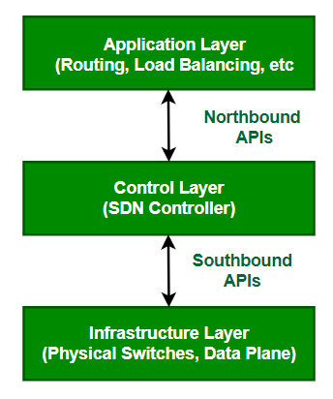
Application Layer: It contains the typical network applications like intrusion detection, firewall, and load balancing.
Control Layer: It consists of the SDN controller which acts as the brain of the network. It also allows hardware abstraction to the applications written on top of it.
Infrastructure Layer: This consists of physical switches which form the data plane and carries out the actual movement of data packets.
The layers communicate via a set of interfaces called the north-bound APIs(between the application and control layer) and southbound APIs(between the control and infrastructure layer).

Slide 36
Data Plane
All the activities involving and resulting from data packets sent by the end-user belong to this plane.
Data Plane includes:
Forwarding of packets.
Segmentation and reassembly of data.
Replication of packets for multicasting.

Slide 37
Control Plane
All activities necessary to perform data plane activities but do not involve end-user data packets belong to this plane.
In other words, this is the brain of the network. The activities of the control plane include:
Making routing tables.
Setting packet handling policies.

Slide 38
Software-Defined Networking (SDN) Works
In Software-Defined Networking (SDN), the software that controls the network is separated from the hardware.
SDN moves the part that decides where to send data (control plane) to software, while the part that actually forwards the data (data plane) stays in the hardware.
This setup allows network administrators to manage and control the entire network using a single, unified interface.
Instead of configuring each device individually, they can program and adjust the network from one central place.
This makes managing the network much easier and more efficient.
In a network, physical or virtual devices move data from one place to another. Sometimes, virtual switches, which can be part of either software or hardware, take over the jobs of physical switches.
These virtual switches combine multiple functions into one smart switch.
They check the data packets and their destinations to make sure everything is correct, then move the packets to where they need to go.

